Slide 1



Deep Soccer Analytics: Learning An Action-value Function For Evaluating Soccer Players
Guiliang Liu
Yudong Luo
Oliver Schulte
Tarak Kharrat

Slide 2
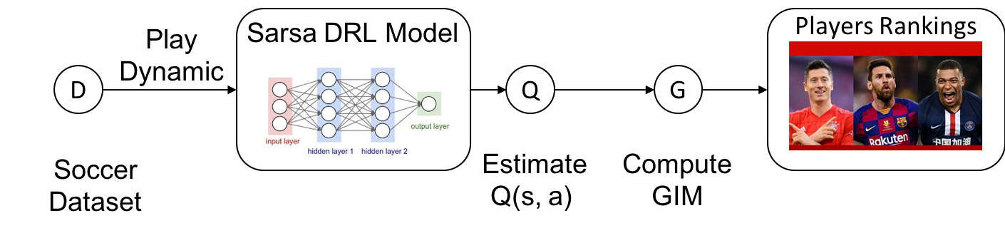
Overview
Learning an Action-Value Q Function for soccer player evaluation:
Modeling play dynamics based on a Markov Game Process (s,a,r).
Build a Deep Reinforcement Learning (DRL) model to compute action-value Q function.
Compute a Game Impact Metric (GIM).
Rank player and evaluate their performance.
Examine the model with a Multi-League play-by-play dataset.
Notes:
For Yudong (这一页用一分钟讲完，每一条都口头补充一些细节，我就比放在ppt里面了，否则显得太乱):
Play dynamics covers both temporal and spatial features, including player locations, game times and ball speed. S=state, A=action and R=rewards， rewards are goals.
Deep Reinforcement Learning: We are using a on-policy Sarsa method. The Q function follows the actions of players in real game. It is not a controlling model.
GIM is the difference two consecutive Q values.
Ranking are within each league. We providing both an overall ranking and action-specific ranking (e.g., ranking players by their shots and assist strength).
We examine the correlation between our GIM metrics and other standard success measures (e.g. goal, assistant, block, etc.)
it is a simple overview, we will more details in the later

Slide 3
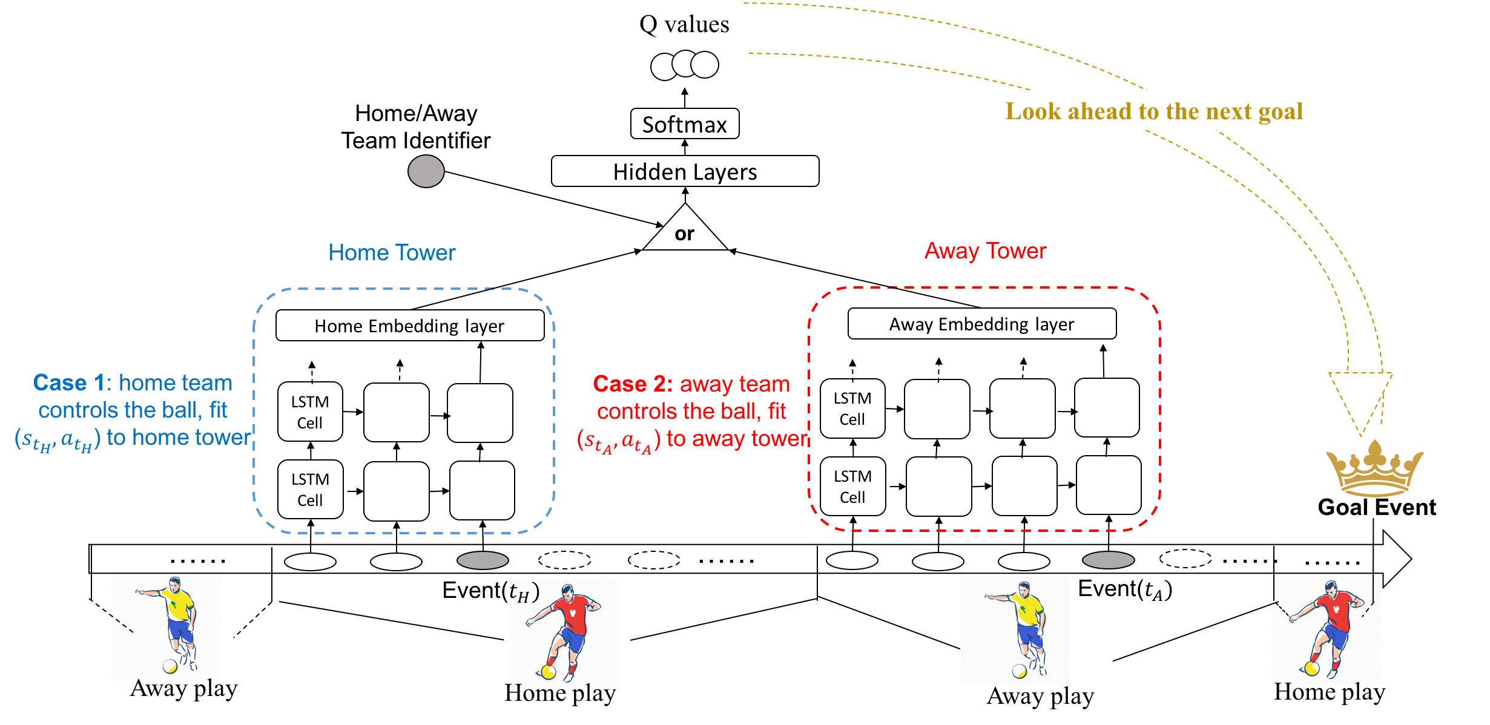
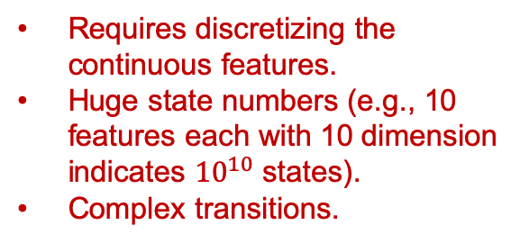
Motivation
Why Deep Reinforcement Learning (DRL):
Previous Model-based methods [1,2,3]:
Explicitly construct a Markov Model.
Model building and function learning are independent.
Infeasible for large dataset.
Our Sarsa DRL model:
Model-Free RL ( no pre-built models).
An end-to-end model (no data pre-processing, no intermediate model).
Generalize to large dataset (mini-batch gradient descent fits dataset with any size).
Requires discretizing the continuous features.
Huge state numbers (e.g., 10 features each with 10 dimension indicates ${10}^{10}$ states).
Complex transitions.
[1] Routley, Kurt, and Oliver Schulte. "A Markov Game model for valuing player actions in ice hockey." Proceedings of the Thirty-First Conference on Uncertainty in Artificial Intelligence. 2015.
[2] Schulte, Oliver, et al. "A Markov Game model for valuing actions, locations, and team performance in ice hockey." Data Mining and Knowledge Discovery 31.6 (2017): 1735-1757.
[3] Cervone D, D’Amour A, Bornn L, Goldsberry K (2016) A multiresolution stochastic process model for predicting basketball possession outcomes. J Am Stat Assoc 111(514):585–599
Notes:
For Yudong:
(1) Independency means it is not an end-to-end process. Performance will be undermined.

Slide 4
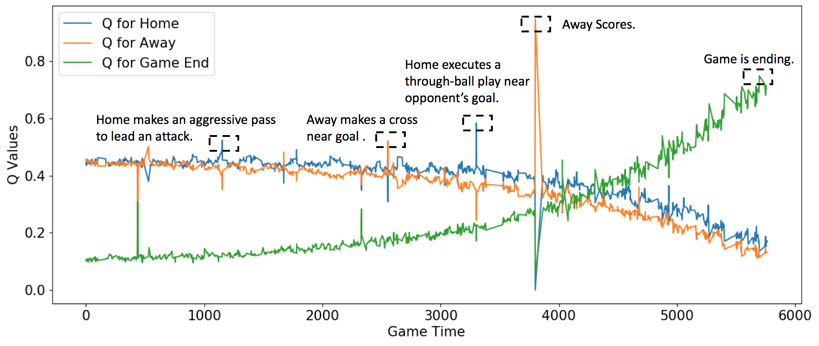
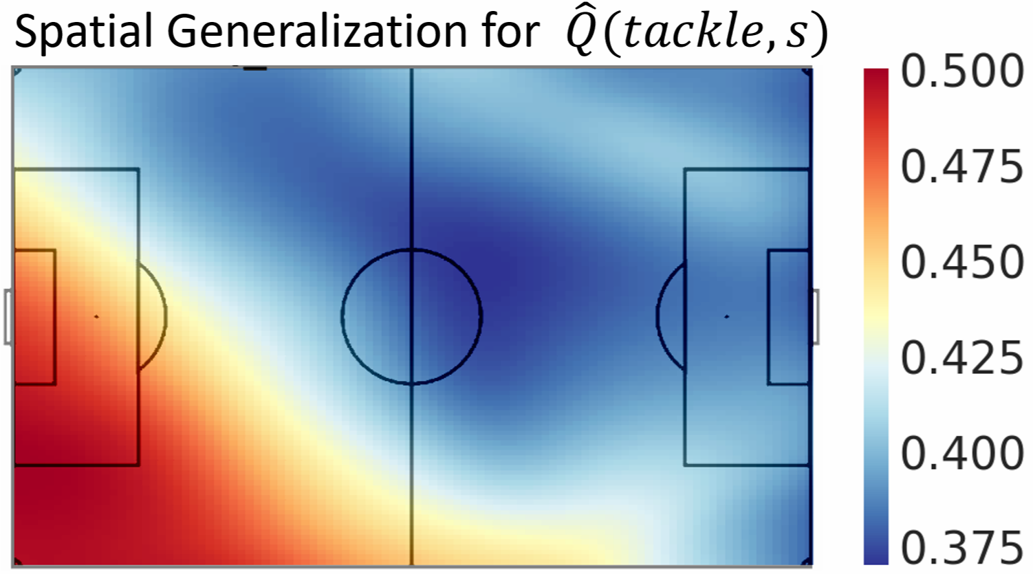
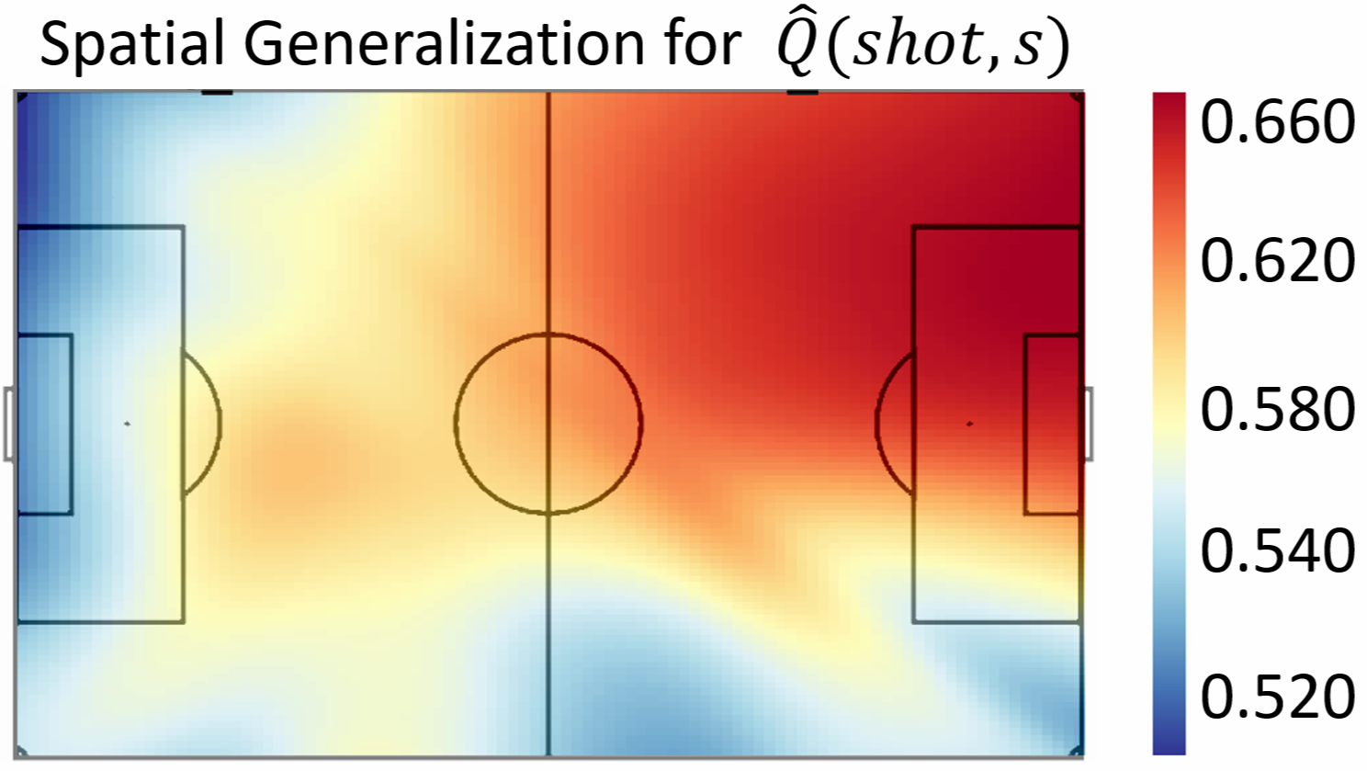
Preliminary Result
Visualizing the Q functions learned by DRL:
Temporal Projection
Q values for a game between Fulham (Home) and Sheffield Wednesday (Away), which has happened on Aug. 19th, 2017.
Q functions represents the probability of home/away team score the next goal or nobody score.
Spatial Projection
Q functions for actions: shots and tackles.
Q function (learned by DRL) generalizes from observed states and actions to those that have not occurred.
Notes:
For Yudong:
Temporal Projection:
We have marked the important events.
We observe (1) High scoring probabilities for one team decrease those of its opponent. (2) The probability that neither team scores rises significantly at the end of the match.
Spatial Projection
The play flows from left to right
Our neural model can generalize from observed states and actions to those that have not occurred in the observed game season. That’s why we can plot Q values at any position of a soccer pitch.
the Q value of offensive actions like shots increases with proximity to the opponent’s goal.

Slide 5
THANK YOU!
Notes:
Thank you for your time and interest today!

Slide 6
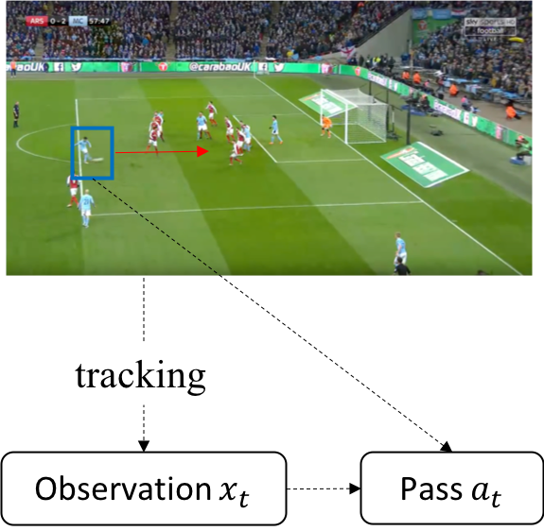
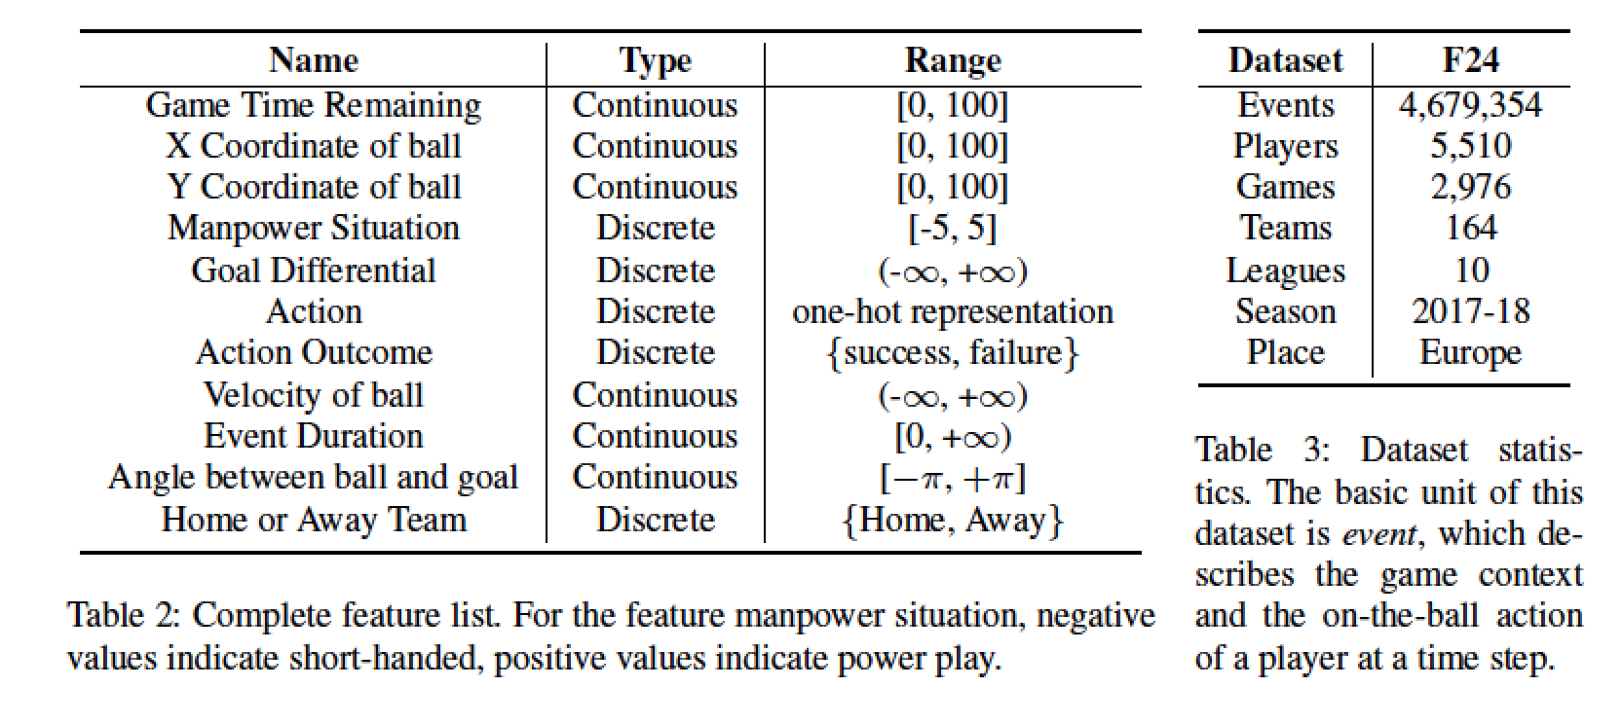
Dataset and Preprocessing
A play-by-play soccer dataset for sports analytic
Records the actions of on-the-ball players and the spatial and the temporal context features.
Multiple leagues, multiple teams and players.
Notes:
For Yudong:
The dataset is about Europe soccer, with over 4M events (large size). Over 5 K players in 164 teams.
Spatial features includes X,Y locations of ball and players. Temporal features include the game time, velocity and duration.
Multiple leagues, includes English Premier League, Dutch Eredivisie, EFL Championship, Italian Serie A, German Bundesliga, Spanish La Liga, French Ligue 1 and German Bundesliga Zwei

Slide 7
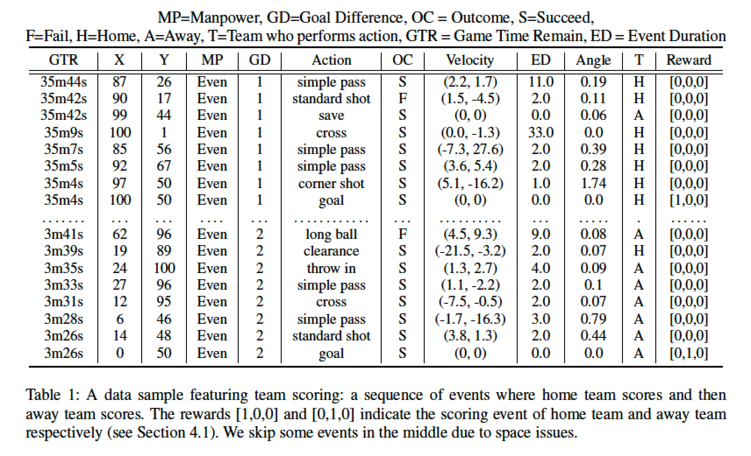
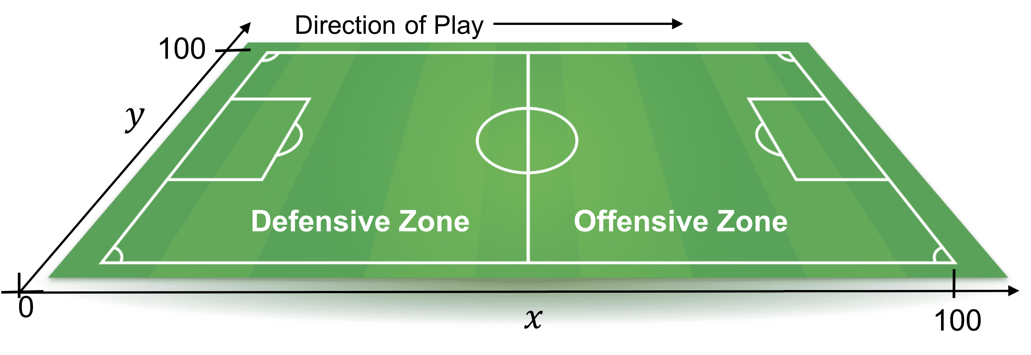
Dataset and Preprocessing
The dataset utilizes adjusted spatial coordinates
Both the X-coordinates and Y-coordinates are adjusted to [0, +100].
We reverse the coordinates when the team in possession attacks towards the left
The play flows from left to right for either team on the adjusted soccer pitch.
Notes:
For Yudong:
go back to slides 4, telling them why the higher Q values for shot are on the right (because it is where both team attack).
A dataset example after preprocessing, at each time step, we record one action, so it is partially observable.

Slide 8
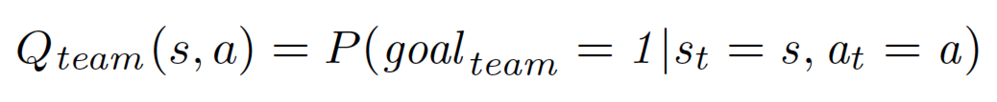
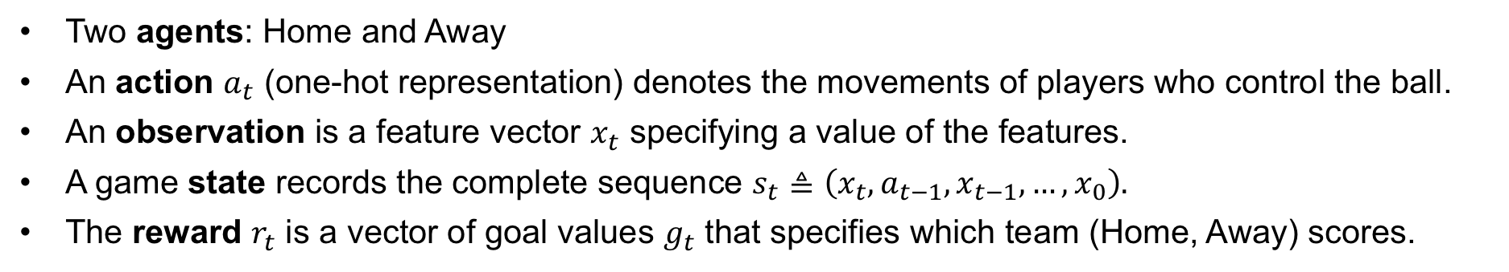
Play Dynamic in Soccer
A Markov model for soccer games.
Two agents: Home and Away
An action $a_{t}$ (one-hot representation) denotes the movements of players who control the ball.
An observation is a feature vector $x_{t}$ specifying a value of the features.
A game state records the complete sequence $s_{t}≜\left(x_{t},a_{t−1},x_{t−1},…,x_{0}\right).$
The reward $r_{t}$ is a vector of goal values $g_{t}$ that specifies which team (Home, Away) scores.
An action-value Q function.
Divide a soccer game into goal-scoring episodes. 1) starts at the beginning of the game, or immediately after a goal, and 2) terminates with a goal or at the end of the game.
The next-goal Q-function represents the probability that the home resp. away team scores the goal at the end of the current goal-scoring episode.
Notes:
For Yudong:

Slide 9
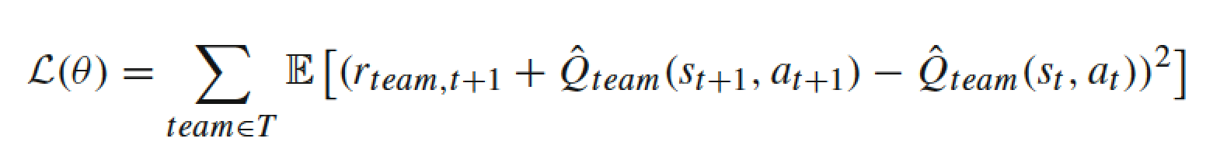
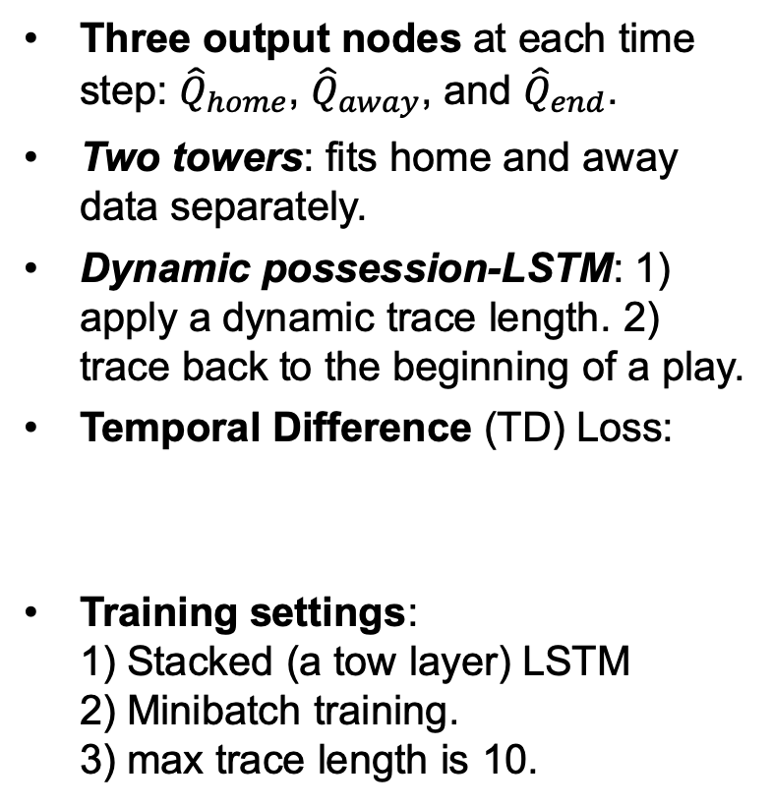
Model Structure
Two-Tower Dynamic Play LSTM (TTDP-LSTM)
Three output nodes at each time step: ${\hat{Q}}_{home}$, ${\hat{Q}}_{away}$, and ${\hat{Q}}_{end}$.
Two towers: fits home and away data separately.
Dynamic possession-LSTM: 1) apply a dynamic trace length. 2) trace back to the beginning of a play.
Temporal Difference (TD) Loss:
Training settings: 1) Stacked (a tow layer) LSTM 2) Minibatch training. 3) max trace length is 10.
Notes:
For Yudong:
Two towers: because from domain knowledge we expect the Q values to be different depending on whether a team plays at home or away (for a discussion of the home team advantage see (Swartz and Arce 2014)).
Dynamic possession LSTM: Team sports like soccer have a turn-taking aspect where one team is on the offensive and the other defends; one such turn is called a play. A play ends when possession passes from the team at time t to the opposing team at time t +1.
Dynamic possession LSTM: LSTM can restrict the history traces to the continuous possession of one team

Slide 10
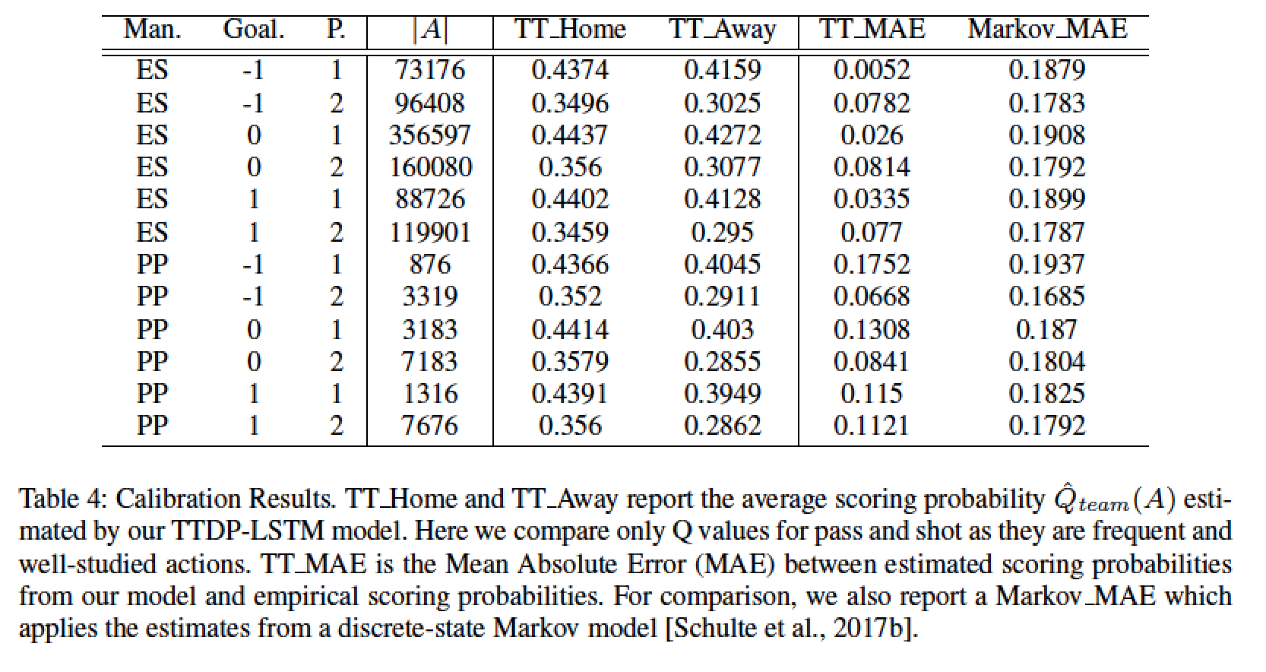
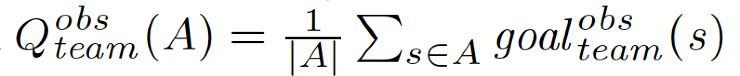
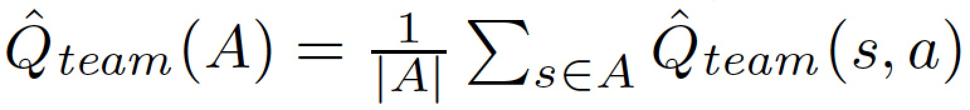
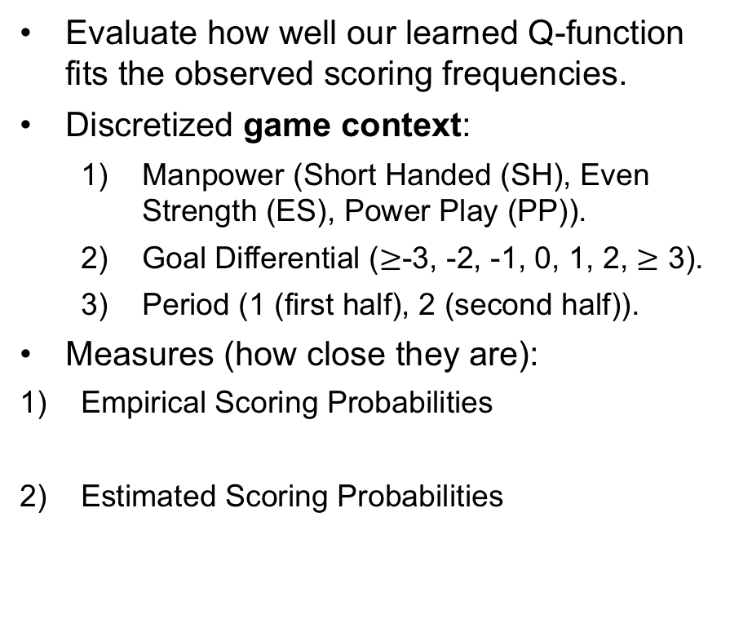
Model Validation: Q Values
Illustration of Temporal and Spatial Projection:
Go back to slide 4
Calibration Quality for the learned Q-function:
Evaluate how well our learned Q-function fits the observed scoring frequencies.
Discretized game context:
Manpower (Short Handed (SH), Even Strength (ES), Power Play (PP)).
Goal Differential ($≥$-3, -2, -1, 0, 1, 2, $≥$ 3).
Period (1 (first half), 2 (second half)).
Measures (how close they are):
Empirical Scoring Probabilities
Estimated Scoring Probabilities
Notes:
For Yudong:
Conclusion1: The model fit is satisfactory (i.e., the average MAE for all bins is below 0.1), except for some relatively rare game contexts.
Conclusion2: Our model significantly outperforms the Markov Model with a discrete state space. This shows the advantage of a function approximation model that can utilize continuous space-time information without losing information due to discretization.

Slide 11
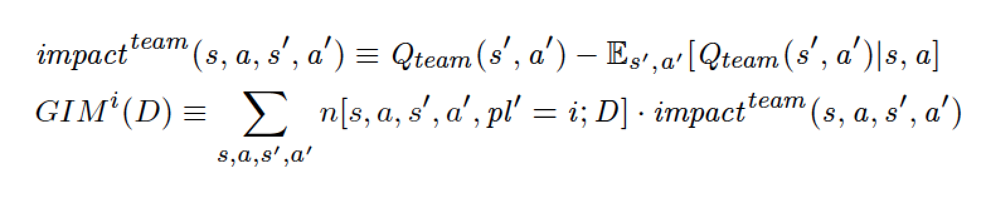
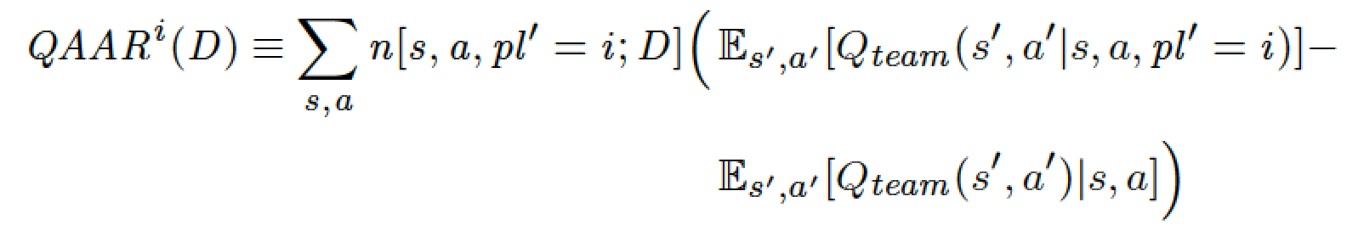
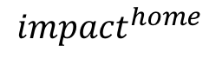
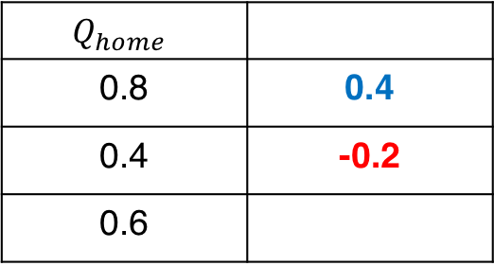
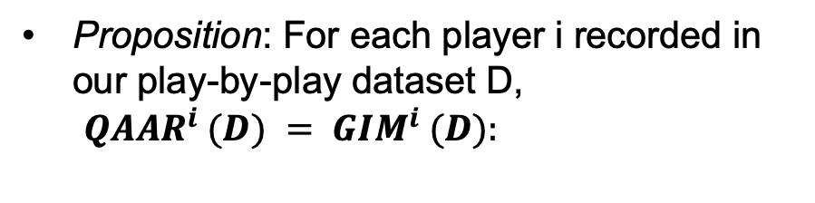
Player Evaluation Metric
Goal Impact Metric (GIM):
Compute the impact of an action by
How much it changes the expected total reward of a player’s team.
Or the difference in expected total reward before and after the player acts.
GIM calculates the total impact of a player’s action:
$$Q_{home}$$
0.8 | 0.4
0.4 | -0.2
0.6
$${impact}^{home}$$
Q Value Above Average Replacement (QAAR):
The QAAR metric compares 1) the expected total future reward given that player i acts next, to 2) the expected total future reward given that a random replacement player acts next:
Proposition: For each player i recorded in our play-by-play dataset D, ${QAAR}^{i} (D) = {GIM}^{i} (D):$
Notes:
For Yudong:
Explain the GIM formula: 1) Q values comes from our neural model.
Explain the GIM formula: 2) n[s; a; s’; a’; pl’ = i ;D] is the number of occurrences that player i performs action a0 at s0 after s; a
Explain the GIM formula: 3) the expectation term can be represent be the Q (s,a), so the impact equation reduces to the difference in Q values before and after the player acts.
Proposition: Our main theorem states that a player’s Q-value-above-average-replacement gives the same score as their total action impact value. This means that the DRL framework unifies the two fundamental approaches to player evaluation; the plausibility of the average replacement approach supports our total action value metric (GIM).

Slide 12
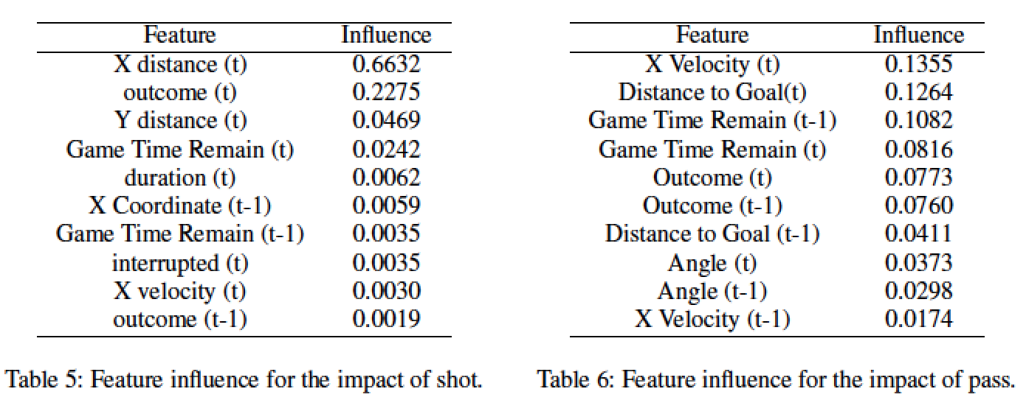
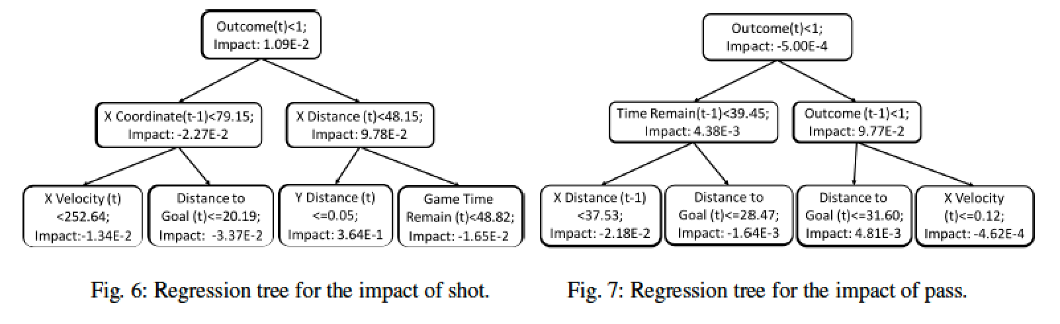
Mimic Decision Tree
Understanding Impact Values with Mimic Decision Tree:
Target: Understand why some actions have large impacts under certain game contexts.
Method: Mimic Decision Tree.
Feed states and actions into a CART to fit the impact values via supervised learning.
Compute the feature importance with the learned tree.
Some results (Top 10 important features for shot and pass):
Some findings:
Shot impact significantly increases as a player approaches the goal.
Passing impact increases with game velocity.
Notes:
For Yudong:
CART means classification and regression tree.
feature importance sums up the variance reductions at the splits applying this feature.
Approach the goal: this finding is consistent with our finding in the spatial projection for Q values.

Slide 13
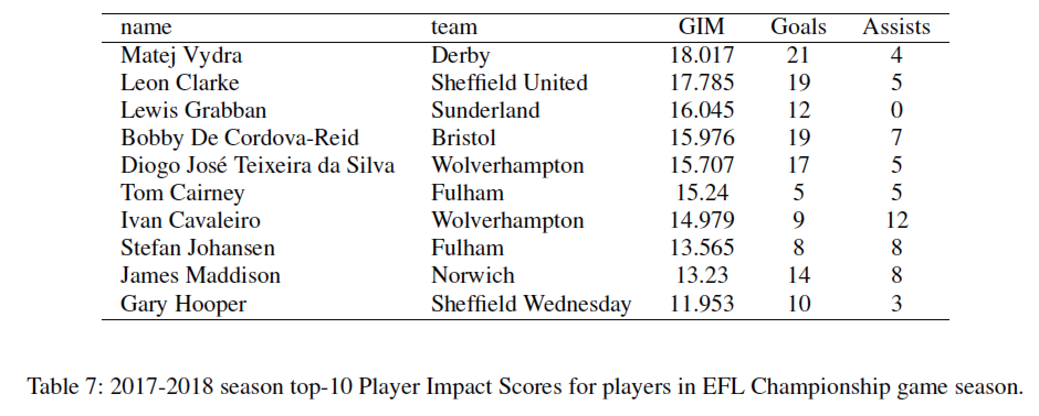
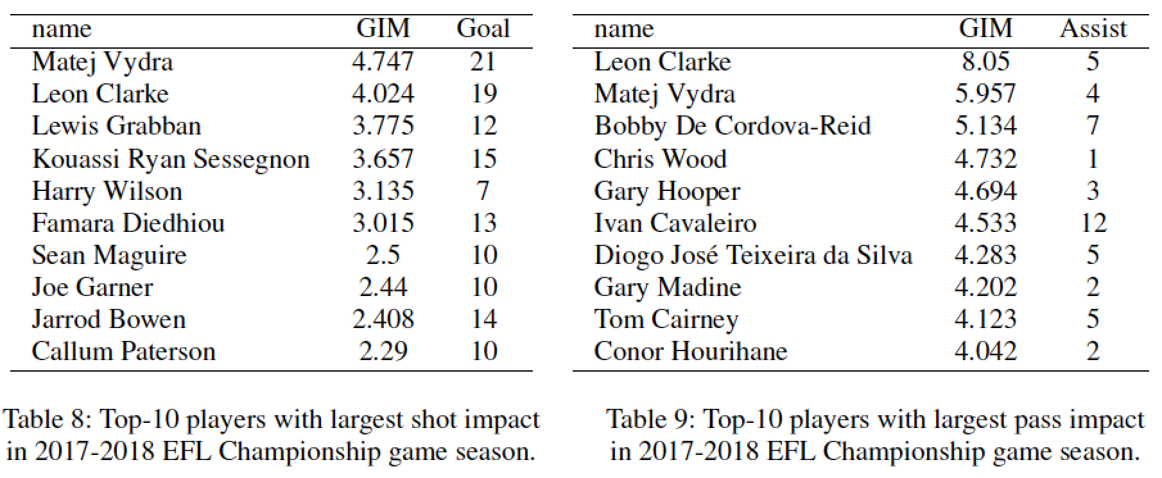
Player Ranking: Case Study
Fine-Tuning:
Motivation: Different leagues have their competition level, season length, and playoff agenda.
Approaches: (EFL Championship games)
Train a general model to evaluate actions in European soccer.
Fine-tune the weight values from the general model to a league specific model.
All-Actions Assessment:
Action-Specific Assessment:
Top shot players
Top passing players
Matej Vydra tops our 2017-2018 season ranking.
Top shot players lead the goal scoring.
Top passing players may not have leading assists.
Notes:
For Yudong:
Matej Vydra dominated the scoring board of the England Championship league and won the 2017-18 Golden Boot award2. In the next season (2018-2019), the Premier League team Burnley recognized the talent of Vydra and signed him on a three-year deal from team Derby.
may not have leading assists: The number of assists is an incomplete measure of passing ability because it neglects midfield and defensive zone passes. Our ranking, in contrast, provides a comprehensive evaluation to all the passes of a player. For example, Conor Hourihane plays as Midfielder and managed only 2 assists over the entire season. But he makes many influential passes and is ranked as a top-10 passer by our metric.

Slide 14
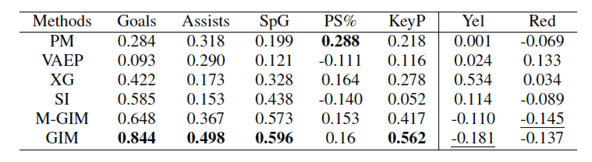
Player Ranking: Empirical Evaluation
Comparison Player Evaluation Metrics:
Goal-based Metrics :
Plus- Minus (PM): measures how much the presence of a player influences the goals of his team.
Expected Goal (XG): weights each shot by its chance of leading to a goal.
All-Action Metrics：
Valuing Actions by Estimating Probabilities (VAEP) applies the difference of action values to compute the impact of on-the-ball actions.
Scoring Impact (SI)： based on a Markov model with pre-discretized spatial and temporal features.
M-GIM: merges our home/away towers and fits all the states and actions with a single-layer network.
Correlations with Standard Success Measures (all players) :
GIM achieves promising correlation with most success measures.
Our model correctly recognizes that a penalty reduces the scoring probability, influencing the overall player GIM.
Notes:
For Yudong:
Correlations with Standard Success Measures :This experiment reports the correlations between player ranking metrics and commonly used success measures over the entire 2017-18 game season
promising correlation :the neural network model allows GIM to handle continuous inputs without pre-discretization, it explains why both GIM and M-GIM perform better than SI in most success measures.
promising correlation The higher correlation of GIM compared to M-GIM also demonstrates the value of separately modeling home/away data.

Slide 15
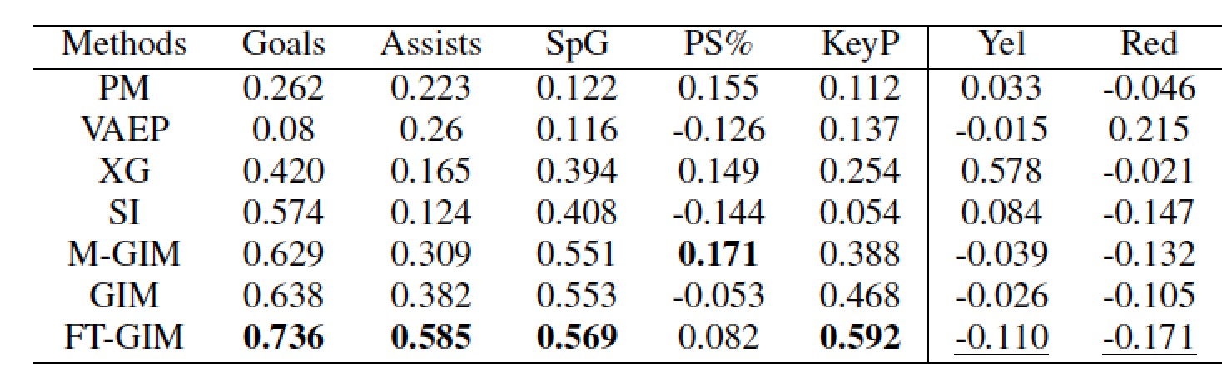
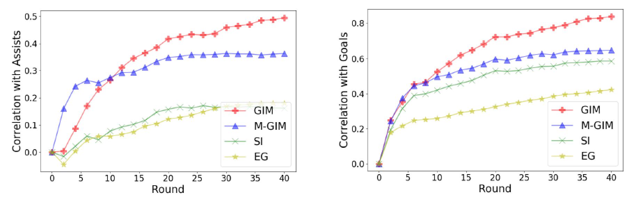
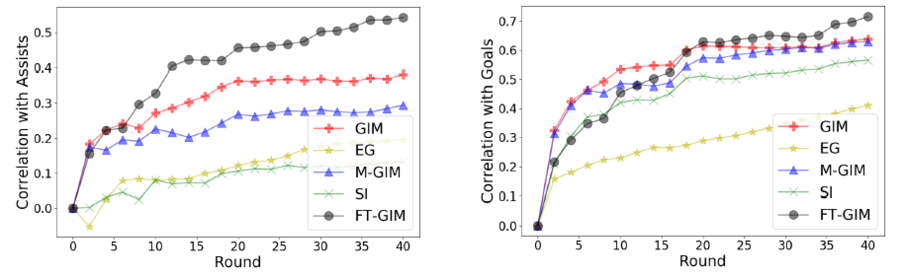
Player Ranking: Empirical Evaluation
Correlations with Standard Success Measures ( EFL Championship players) :
Championship League players’ correlations generally decrease.
it is more severe for our GIM metric.
Fine-tuning (FT-GIM) addresses this issue.
Round-by-Round Correlations: Predicting Future From Past Performance :
All players
Players in the EFL Champion leagues
Notes:
For Yudong:
more severe: The correlations nearly drop 20% when the players in the Championship League are evaluated by the general model
Round-by-Round Correlations: For a given performance metric, we measure the correlation between (i) its value computed over the first n rounds, and (ii) the value of the two main success measures, assists, and goals, computed over the entire season. This allows us to assess how quickly different metrics acquire predictive power for the final season total, so that future performance can be predicted from past performance.
For all player evaluation: GIM grows more quickly than with any other baseline: its correlation with both assists (left) and goals (right) dominates others before the first half of the season.
For EFL Champion leagues: Fine-tuning significantly improves the correlations of GIM, especially for its correlation with assists, where the correlation of FT-GIM exceeds that of other metrics after the first 10 rounds.

Slide 16
Conclusion
Key takeaways :
Q function from Sarsa Temporal Difference (TD) Learning:
Neural function approximator fits well with the high dimensional Spatial-temporal data.
TD method provides a promising evaluation to action-state.
Action Impact :
Cancel influence from previous action and focus only on current actions.
Effectively evaluate the influence of agent’s action
Domain knowledge:
Home/away team behaves differently.
Players in different soccer league should be evaluated separately.
Action impact correlates well with standard success measures (e.g., goal, shot, etc.,)

